Slide 1
IR and Mass Spec Webquest
Suzanna Newton 12 Fisher

Slide 2
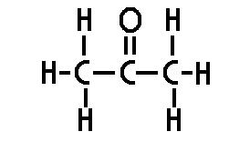
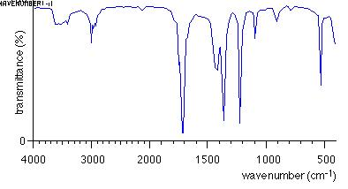
Propanone
I believe that this is the IR spectrum for propanone, as the strong peak at about 1700 cm⁻¹ indicates a C=O bond, and the very small peak between 2850 and 3100cm⁻¹ reflects the other C-H bonds in the molecule. The peak at 1700cm⁻¹ is the only peak of that strength in the spectrum, demonstrating that this is the only other bond in the molecule.
C-H
C=O
The lack of multiple peaks between 2500 and 3000cm⁻¹ demonstrates that this molecule is not an aldehyde, as these multiple peaks are characteristic of aldehydes. The molecule therefore must be a ketone, proving that this is the IR spectrum for propanone.

Slide 3
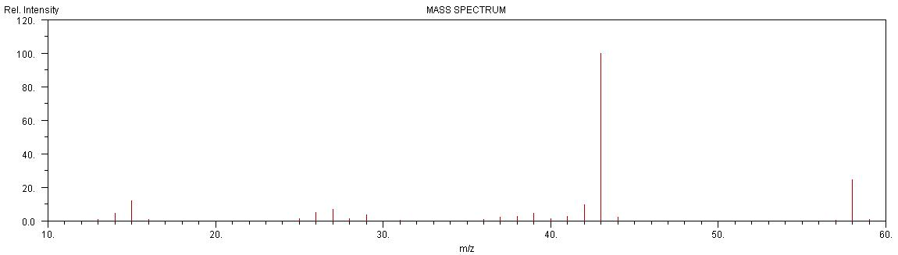
C₂H₃OH
CH₃
M+
During fragmentation in a mass spectrometer, propanone forms 3 main fragments. Its molecular ion (M+), with an m/z of 58, a methyl group, CH₃ , with an m/z of 15, and the rest of the molecule consisting of 2 carbon atoms, 3 hydrogen and 1 oxygen (double bonded to a carbon atom), giving it an m/z of 43.
The mass spectrum shown above shows strong peaks at all 3 of these m/z’s, with small peaks next to them indicating the isotopic fragments. As there are no other strong peaks, this mass spectrum is clearly for propanone.

Slide 4
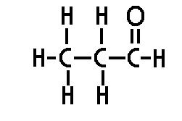
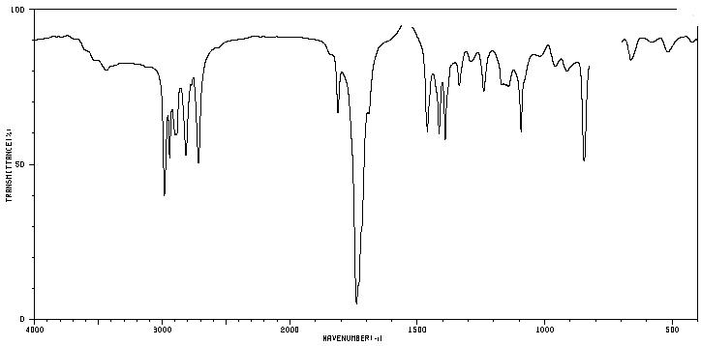
Propanal
Similarly to the IR spectrum for propanone, the strongest peak on this spectrum is between 1640 and 1750cm⁻¹, indicating a C=O bond, the only bond in an aldehyde which would demonstrate a strong peak on an IR spectrum.
Peaks showing an aldehyde
C=O
Unlike that for propanone however, this IR spectrum shows multiple small peaks between 2500 and 3000cm⁻¹, clearly indicating that this spectrum is for an aldehyde as opposed to a ketone. For these reasons I believe that this is the Infrared Spectrum for propanal.

Slide 5
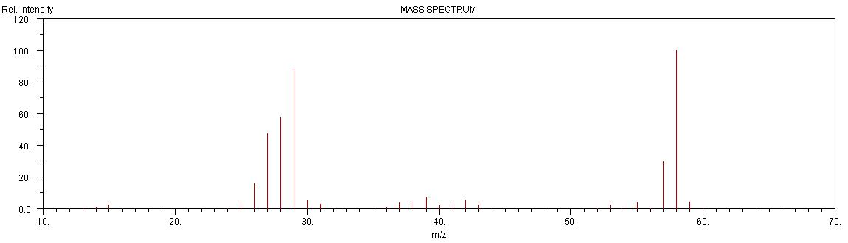
M+
CHO or C₂H₅
CH₃
C₂H₃O
During fragmentation, propanal forms more fragments than propanone, forming its molecular ion with m/z 58, C₂H₅ with m/z 29, CHO with m/z 29, CH₃ with m/z 15, and C₂H₃O with m/z 43.
From looking at the spectrum, it is evident that these fragments are present, along with some isotopic fragments, indicating propanal.
The base peak on the right at m/z 58 shows the presence of the molecular ion, showing that the overall mass of the original molecule is 58, and supporting the conclusion that this is a mass spectrum for propanal.

Slide 6
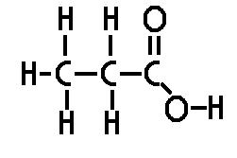
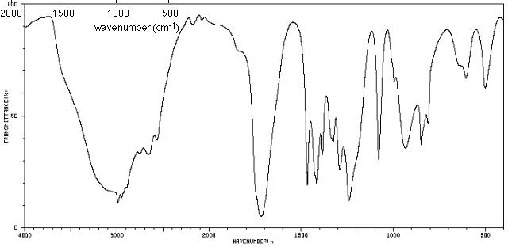
Propanoic acid
On this IR spectrum a very broad peak is visible between 2500 and 3300cm⁻¹, indicating an O-H group and also showing that this is a carboxylic acid due to how broad the peak is.
Another particularly strong peak on this spectrum is between 1640 and 1750cm⁻¹, demonstrating the presence of a C=O bond.
O-H
Carboxylic acid
C=O
C-O
The only other significantly strong peak on this spectrum is the one between 1000 and 1300cm⁻¹, and it shows that there is a C-O bond in this molecule.
All 3 of these bonds together support the conclusion that this is the IR spectrum for propanoic acid.

Slide 7
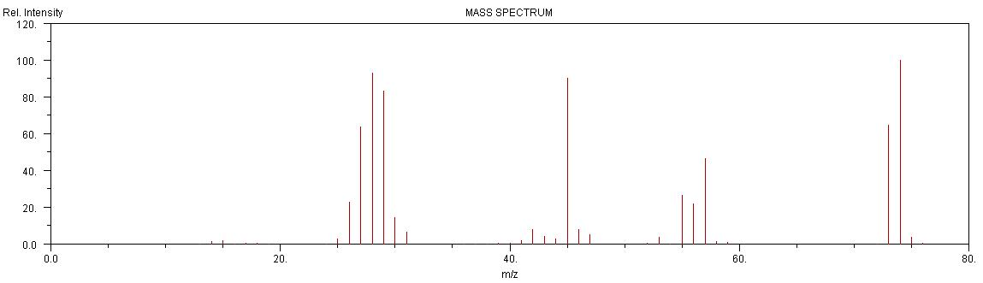
COOH
M+
C₃H₅O
C₂H₅
When fragmented, propanoic acid splits into its molecular ion (m/z 74), C₂H₅ (m/z 29), COOH (m/z 45), C₃H₅O (m/z 57) and OH (m/z 17).
Although the peak for m/z 17 is extremely small, the rest of the peaks for these fragments are all clear on the spectrum, with the base peak (the highest peak to the right of the graph) being at m/z 74 and again supporting the fact that this mass spectrum shows the results from putting propanoic acid into a mass spectrometer.

Slide 8
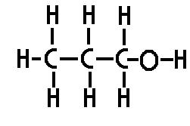
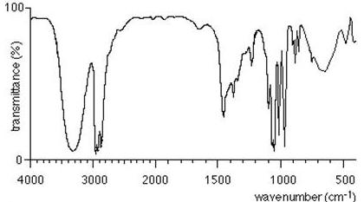
Propan-1-ol
This final IR spectrum very clearly shows the results for propanol. To the right of the spectrum there is a peak between 1000 and 1300cm⁻¹, showing that there is a C-O bond in the molecule.
Unlike the other IR spectrums, this one does not have a peak between 1640 and 1750cm⁻¹, showing that a C=O bond is not present in this molecule and that it therefore is not an aldehyde, ketone or carboxylic acid.
C-H
O-H (alcohol)
C-O
The peaks between 2850 and 3100cm⁻¹ show that there are many C-H bonds in the molecule also.
The only other significant peak is the reasonably broad one between 3200 and 3550cm⁻¹. This peak shows that there is an O-H bond. As the peak is not broad enough to be for a carboxylic acid, this peak only shows either an alcohol or a phenol.
For all of these reasons I came to the conclusion that this is the IR spectrum for propan-1-ol.

Slide 9
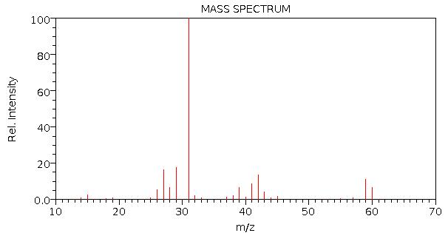
CH₂OH
M+
C₂H₅
CH₃
C₃H₇
During fragmentation, propan-1-ol can form many different fragments, as well as its molecular ion, and some examples are shown in the equations below, with the m/z of each fragment written below them.
C₃H₇OH + e⁻ C₃H₇OH⁺ + 2e⁻
60
C₃H₇OH⁺ + e⁻ C₃H₇⁺ + OH⁺ + 2e⁻
43 17
C₃H₇OH⁺ + e⁻ C₂H₅⁺ + CH₂OH⁺ + 2e⁻
29 31
C₃H₇OH⁺ + e⁻ CH₃⁺ + C₂H₄OH⁺ + 2e⁻
15 45
As we can see on the spectrum above, there are peaks at all of these results, with the strongest peak being at 31, indicating that this is the most common fragment formed. For these reasons, and due to the position of the M+ result, this spectrum must be the mass spectrum for propan-1-ol.

